Slide 1
Ethereum Smart Contract Security
Lect 11

Slide 2
Contents
Crypto Vulnerability
BatchTransfer Error Explained
SafeMath
External Contract Call
Re-entrency Attacks
Hack Demonstrated and Explained
DAO Hack explained
Sending Ether Safely

Slide 3
BatchTransfer Error
The Batch Overflow bug occurs due to a Batch Transfer function call.
The function performs a multiply or addition that is able to overflow 256 bits.
Essentially, Ethereum allows developers to track up to (2²⁵⁶-1) values.
Link (Hyperinflation Vulnerability):
New batchOverflow Bug in Multiple ERC20 Smart Contracts

Slide 4
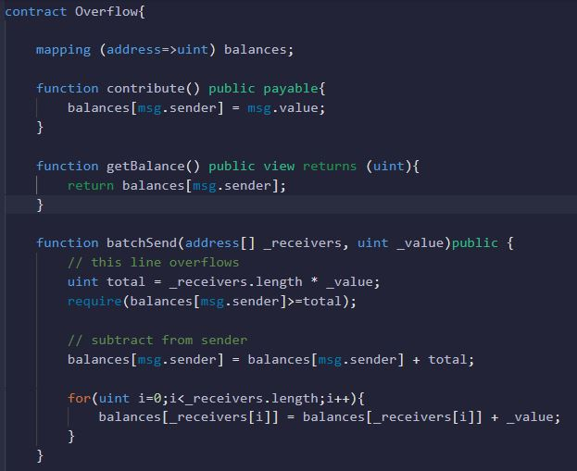
//Vulnerability: That can Overflow

Slide 5
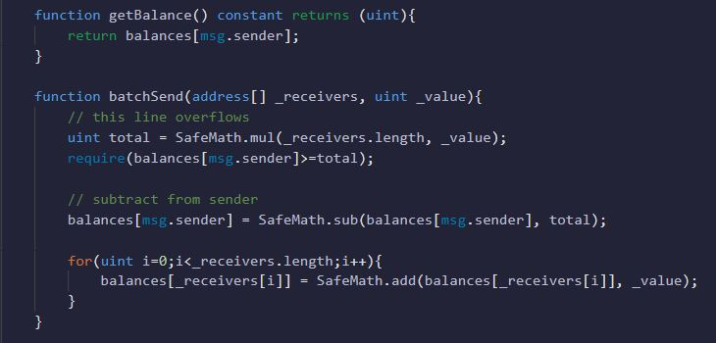
Using SafeMath to solve Problem

Slide 6
SafeMath (Library)
Wrappers over Solidity’s arithmetic operations with added overflow checks.
Arithmetic operations in Solidity wrap on overflow.
This can easily result in bugs, because programmers usually assume that an overflow raises an error, which is the standard behavior in high level programming languages.
SafeMath restores this intuition by reverting the transaction when an operation overflows.
Using this library instead of the unchecked operations eliminates an entire class of bugs, so it’s recommended to use it always.
NOTE: `SafeMath` is generally not needed starting with Solidity 0.8, since the compiler now has built in overflow checking.

Slide 7
External Contract Call Re-entrency Attack

Slide 8
External Contract Call
Calls to untrusted contracts can introduce several unexpected risks or errors.
External calls may execute malicious code in that contract or any other contract that it depends upon.
As such, every external call should be treated as a potential security risk.

Slide 9
Re-entrency Attack
The Reentrancy attack is one of the most destructive attacks in the Solidity smart contract.
A reentrancy attack occurs when a function makes an external call to another untrusted contract.
Then the untrusted contract makes a recursive call back to the original function in an attempt to drain funds.
When the contract fails to update its state before sending funds, the attacker can continuously call the withdraw function to drain the contract’s funds.
A famous real-world Reentrancy attack is the DAO attack which caused a loss of 60 million US dollars.

Slide 10
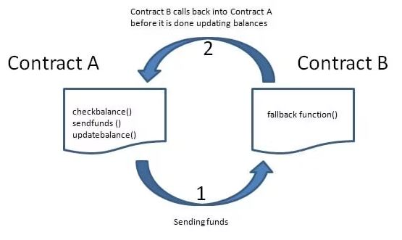
How Does Reentrancy Attack Work
A reentrancy attack involves two smart contracts. A vulnerable contract and an untrusted attacker’s contract.

Slide 11
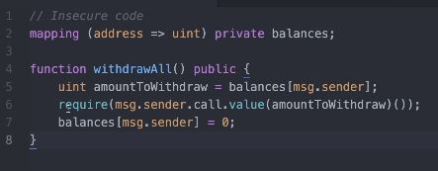
Re-entrency Attack: Insecure Code
//External Contract: Withdraw amount again and again before changing state
//Not best practice for writing this statement here

Slide 12
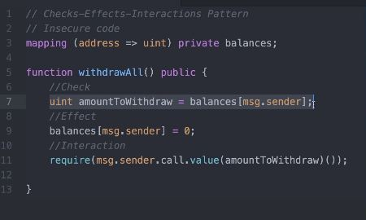
Re-entrency Attack Solution 1) Check 2) Effect 3) Interaction Pattern Note: Re-entrency happens at the middle of the functions.
//State Change before transferring amount

Slide 13
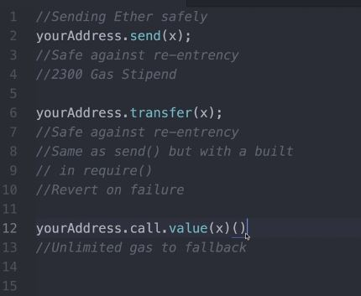
Sending Ether: How to do it Safely

Slide 14
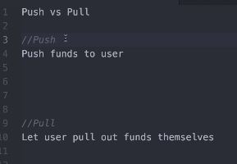
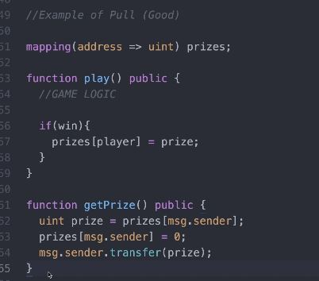
Push & Pull – Contract Design

Slide 15
Reentrancy
Link: Ethereum Smart Contract Best Practices

Slide 16
Hack Demonstrated and Explained DAO Hack Explained

Slide 17
What Is a DAO?
A DAO is a decentralized autonomous organization, a type of bottom-up entity structure with no central authority.
Members of a DAO own tokens of the DAO, and members can vote on initiatives for the entity.
Smart contracts are implemented for the DAO, and the code governing the DAO's operations in publicly disclosed.

Slide 18
What Is the Purpose of a DAO?
A DAO is intended to improve the traditional management structure of many companies.
Instead of relying on a single individual or small collection of individuals to guide the direction of the entity, a DAO intends to give every member a voice, vote, and opportunity to propose initiatives.
A DAO also strives to have strict governance that is dictated by code on a blockchain.

Slide 19
DAO Hack
The token sale was set to last 28 days, during which the tokens were “locked up,” and after which the DAO would begin to operate.
The DAO had raised more than $150 million from more than 11,000 investors, making it one of the largest crowdfunding campaigns in history at the time.
However, even before the token sale had concluded, several onlookers expressed concerns about vulnerabilities in The DAO’s code.
An attacker exploited the vulnerability and began siphoning funds from The DAO.

Slide 20
In the meantime, the Ethereum community debated how to respond to the attack.
The DAO had become such a heavily invested project that its contracts contained approximately 14% of all ether (ETH) in circulation at the time.
At only one year old, the promising Ethereum technology and community was faced with a genuine existential threat.
Read this Article Explaining the DAO Hack
Link: The DAO Hack Explained: Unfortunate Take-off of Smart Contracts

Slide 21
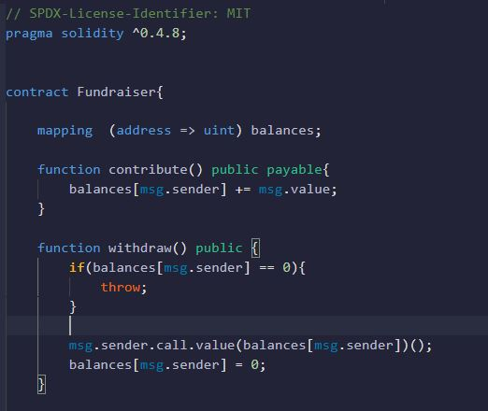
DAO Hack: Replicating the Vulnerability
//Vulnerability in the function

Slide 22
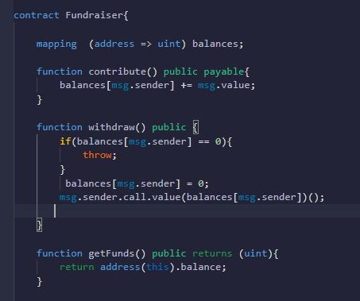
//Fix: By changing Position

Slide 23
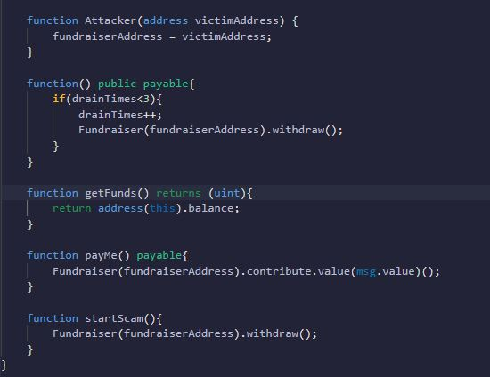

Slide 24

A vulnerability Disclosed in Profanity
Link: A vulnerability disclosed in Profanity, an Ethereum vanity address tool

Slide 25

Wishful Cynic
Link: Wishful Cynic

Slide 26
Purpose of “Unchecked” in Solidity
Link: What is the purpose of "unchecked" in Solidity?

Slide 27
Members of Address Types
Link: Members of Address Types

Slide 28
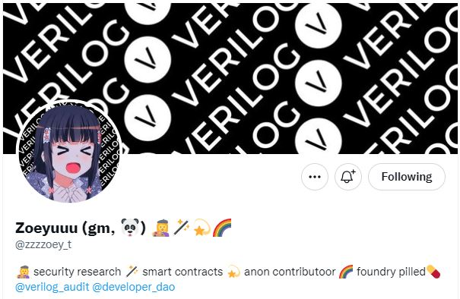
Zoeyuuu
Link: EVM considers calls to non-existing contracts to always succeed.

Slide 29
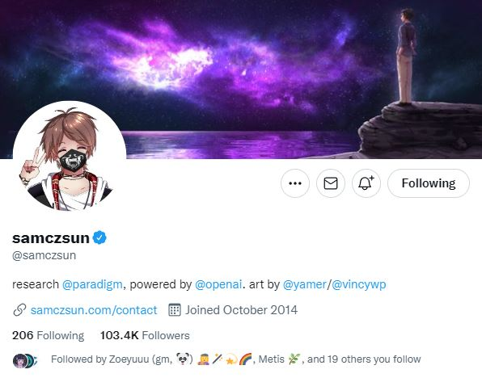
samczsun
Link: For Smart Contract Security (Twitter Account)
Link: samczsun.com

Slide 30

ArmorFi Bug Bounty Postmortem
Link: ArmorFi Bug Bounty Postmortem

Slide 31
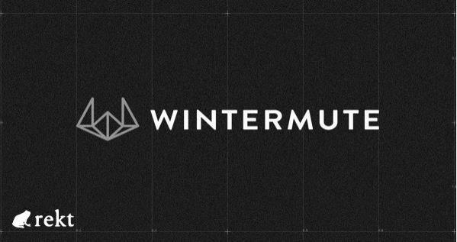
Wintermute have lost over $160M
Link: Wintermute have lost over $160M to their second incident this summer.

